Slide 1
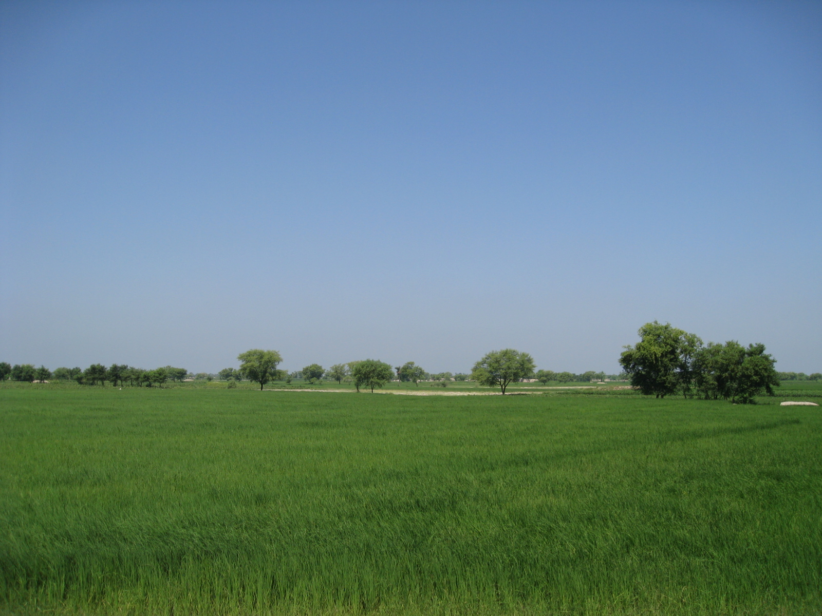
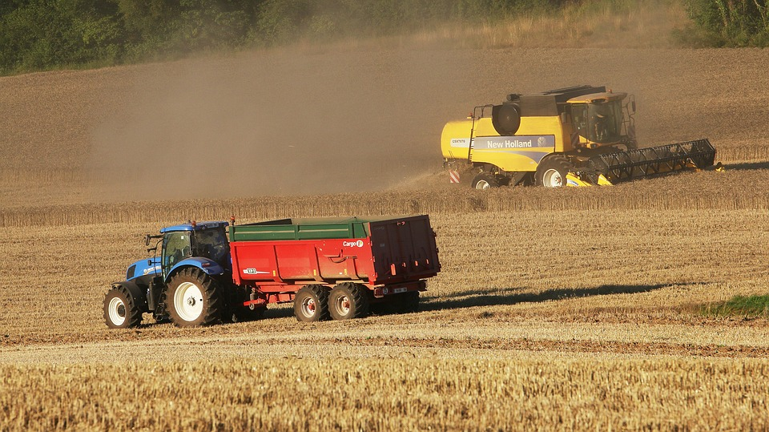
Agriculture Data Analysis and Prediction Dashboard
Introduction
This presentation showcases an interactive dashboard for analyzing agriculture data in India.
The dashboard utilizes K-Means clustering and K-Nearest Neighbors (KNN) to identify patterns and predict crop preferences based on various factors.

Slide 2
It also introduces an interactive tool designed to analyze agriculture data in India. The dashboard identifies patterns and predicts crop preferences based on various agricultural factors using techniques such as K-Means clustering and K-nearest neighbors (KNN). The dashboard aids in understanding high-variance features, visualizing seasonal crop distributions, and providing predictive insights that can inform agricultural decision-making.

Slide 3
Findings
High Variability in Agricultural Factors: Certain agricultural factors show high variability, highlighting the need for focused risk management and resource planning.
Seasonal Crop Performance: Crop yields vary significantly across seasons (Summer, Rabi, Kharif), emphasizing the need for season-specific crop selection to maximize productivity.
Effective Crop Grouping with Clustering: K-Means clustering identified 3-5 optimal clusters, allowing for better grouping of crops with similar characteristics for improved resource use and decision-making.

Slide 4
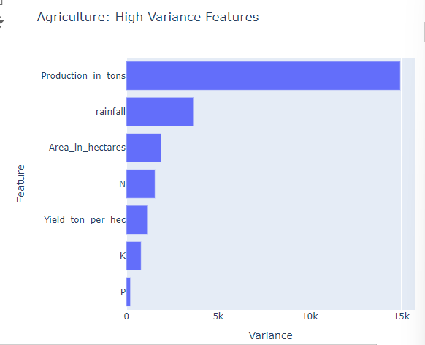
Data Exploration
High Variance Features:
This information can be useful for understanding which factors in agriculture are most variable and may require more attention for risk management and resource planning.

Slide 5
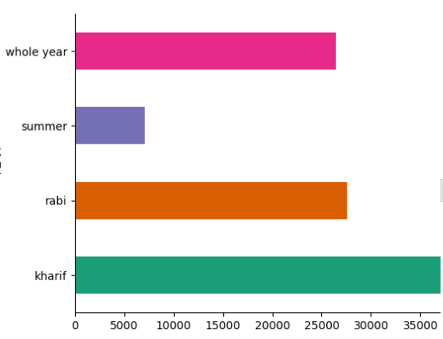
Season Distribution
Whole Year: This bar represents the total value for the entire year.
Summer: Shows the value specifically for the summer season.
Rabi: Represents the value for the Rabi season, which typically includes winter crops.
Kharif: Indicates the value for the Kharif season, which usually includes monsoon crops.

Slide 6
Clustering Analysis
K-Means Clustering: We applied K-Means clustering to group similar data points based on their features.
Inertia and Silhouette Score: We evaluated the clustering performance using inertia and silhouette score

Slide 7
K-Means Model: Inertia vs Number of Clusters
The best number of clusters per their inertia is 4 or 5

Slide 8
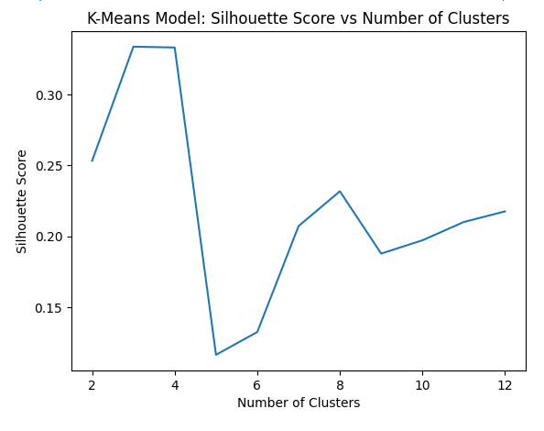
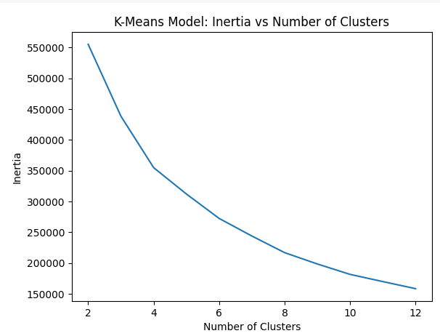
K-Means Model: Silhouette Score vs Number of Clusters
K-Means Model: Inertia vs Number of Clusters
From the above, the best number of clusters is 4

Slide 9
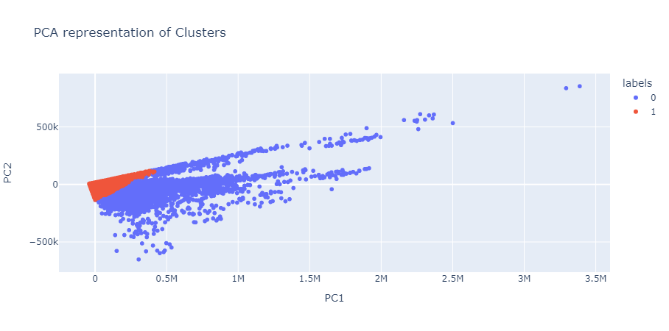
PCA Visualization
We used Principal Component Analysis (PCA) to reduce the dimensionality of the data and visualize the clusters in a 2D scatter plot.

Slide 10
Prediction Model
KNN Model: We built a KNN model to predict crop preferences based on user-provided input values.

Slide 11
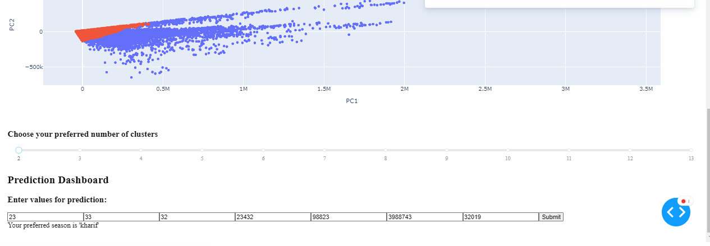
Prediction Dashboard: The dashboard allows users to input values for different features and get a predicted crop preference.

Slide 12
Conclusion
This interactive dashboard provides valuable insights into agriculture data in India. By visualizing data, identifying clusters, and building a prediction model, we can better understand crop production patterns and make informed decisions.
Data Source
https://www.kaggle.com/datasets/srinivas1/agricuture-crops-production-in-india

Slide 13
Recommendations
Season-Specific Crop Planning: Focus on season-appropriate crop planning (Rabi, Kharif, Summer) to optimize production and ensure better yields based on seasonal crop performance.
Data-Driven Resource Allocation: Use K-Means clustering insights to group crops with similar characteristics for efficient resource use, irrigation, and cost management.
Predictive Modeling for Crop Selection: Leverage the KNN-based prediction model to recommend the best crops for a region, improving productivity and sustainability.
Data Source
https://www.kaggle.com/datasets/srinivas1/agricuture-crops-production-in-india

